Slide 1




NEXT GEN EMPLOYABILITY PROGRAM
Creating a future-ready workforce
Team Members
College Name
Student Name : KAVYA V P
Student ID : au960221243029
Arunachala College of Engineering for Women

Slide 2

CAPSTONE PROJECT SHOWCASE
Project Title
Car Rental Application using Django Framework
Abstract | Problem Statement | Project Overview | Proposed Solution | Technology Used | Modelling & Results | Conclusion

Slide 3
Abstract This project aims to develop a Car Rental Application using the Django framework, with HTML, CSS, and JavaScript for the frontend and Python for the backend. The application allows users to browse, search, and rent cars from a fleet managed by the system. It provides a convenient platform for both customers and car rental companies to interact and manage rental transactions efficiently.
Source :

Slide 4
Problem Statement Traditional car rental processes often involve cumbersome paperwork, manual booking systems, and limited accessibility for customers. This project addresses these challenges by developing a user-friendly Car Rental Application that automates the rental process, enhances user experience, and provides seamless communication between customers and rental companies.
Source :

Slide 5
Project Overview The Car Rental Application aims to provide a comprehensive platform for users to rent cars conveniently. It includes features such as user registration and authentication, browsing and searching for available cars, viewing car details and rental prices, making reservations, managing bookings, and providing feedback and ratings. The application will be developed using the Django framework for backend functionality, while HTML, CSS, and JavaScript will be used to create an intuitive and responsive user interface.
Source :

Slide 6
Proposed Solution The proposed solution entails developing a robust Car Rental Application using Django for backend functionality and HTML, CSS, and JavaScript for the frontend. The backend will leverage Django's Model-View-Template (MVT) architecture, facilitating efficient data management and user authentication. Models will define database entities such as users, cars, bookings, and feedback. Views will handle user requests and interact with models, while templates will generate dynamic HTML responses.
Source :

Slide 7
On the frontend, HTML will structure web pages, CSS will style them for a visually appealing interface, and JavaScript will provide interactivity. Users will be able to browse available cars, search based on criteria like location and date, and book rentals seamlessly. Payment processing integration will ensure secure transactions, and user feedback mechanisms will enhance service quality.
Source :

Slide 8
Comprehensive testing will be conducted to ensure functionality, reliability, and security, with measures like input validation and encryption. Deployment to a production environment will follow, with ongoing maintenance and support to address issues and implement updates. Overall, the proposed solution aims to deliver an intuitive and efficient Car Rental Application, streamlining the rental process for users and rental companies alike.
Source :

Slide 9


Technology Used
Front-end
Back-end
Source :

Slide 10
Modelling & Results The application will utilize Django's built-in ORM to model the database schema, including tables for users, cars, bookings, and feedback. User authentication and authorization will be implemented using Django's authentication system. Frontend templates will be designed using HTML and styled with CSS to create visually appealing pages, while JavaScript will be used for client-side interactivity and dynamic content. Upon completion, the Car Rental Application is expected to provide a seamless and efficient rental experience for both customers and car rental companies, improving overall satisfaction and convenience.
Source :

Slide 11
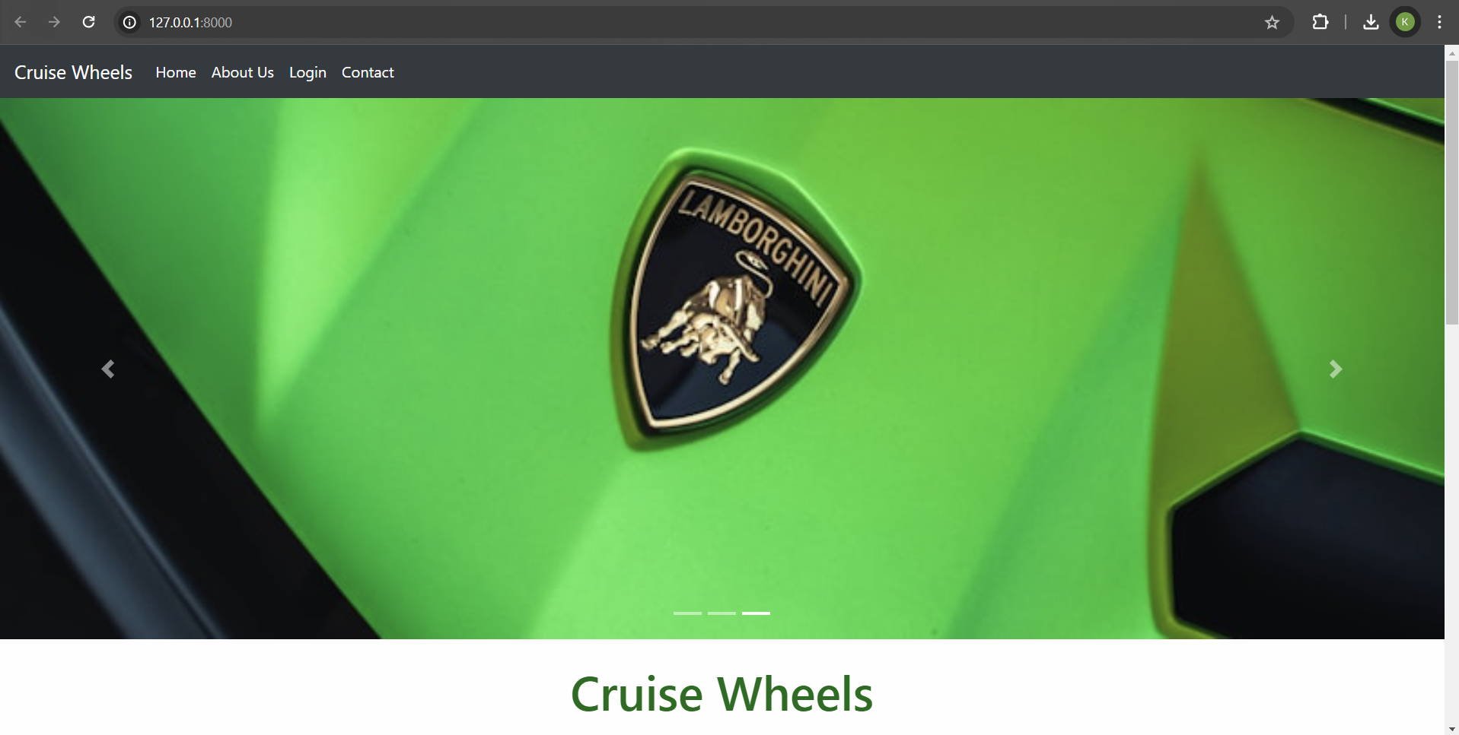
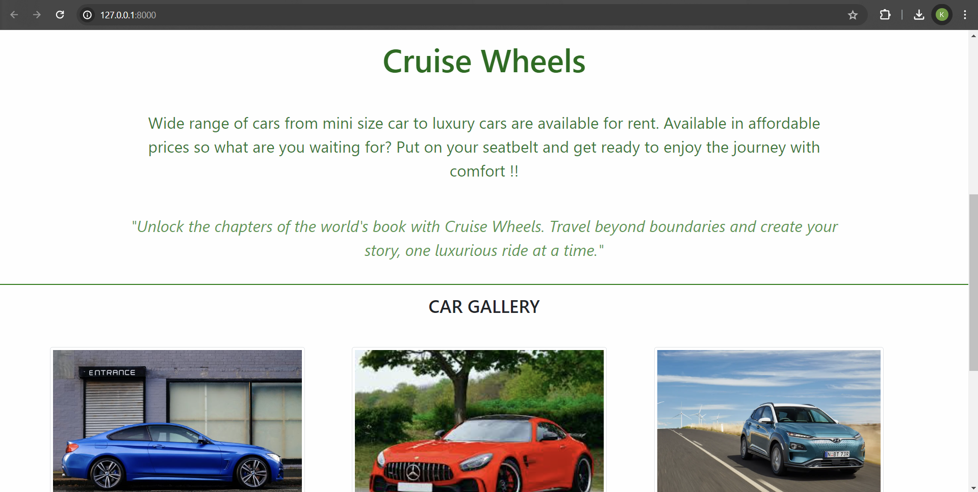
Homepage

Slide 12
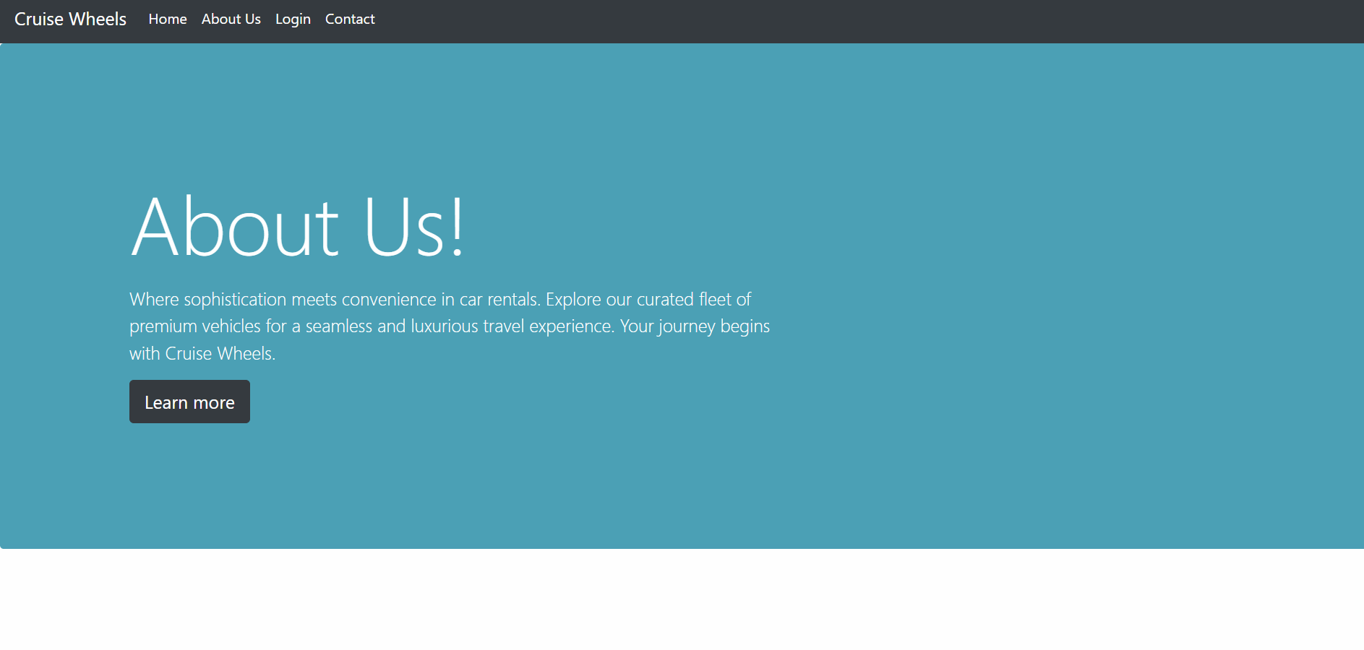
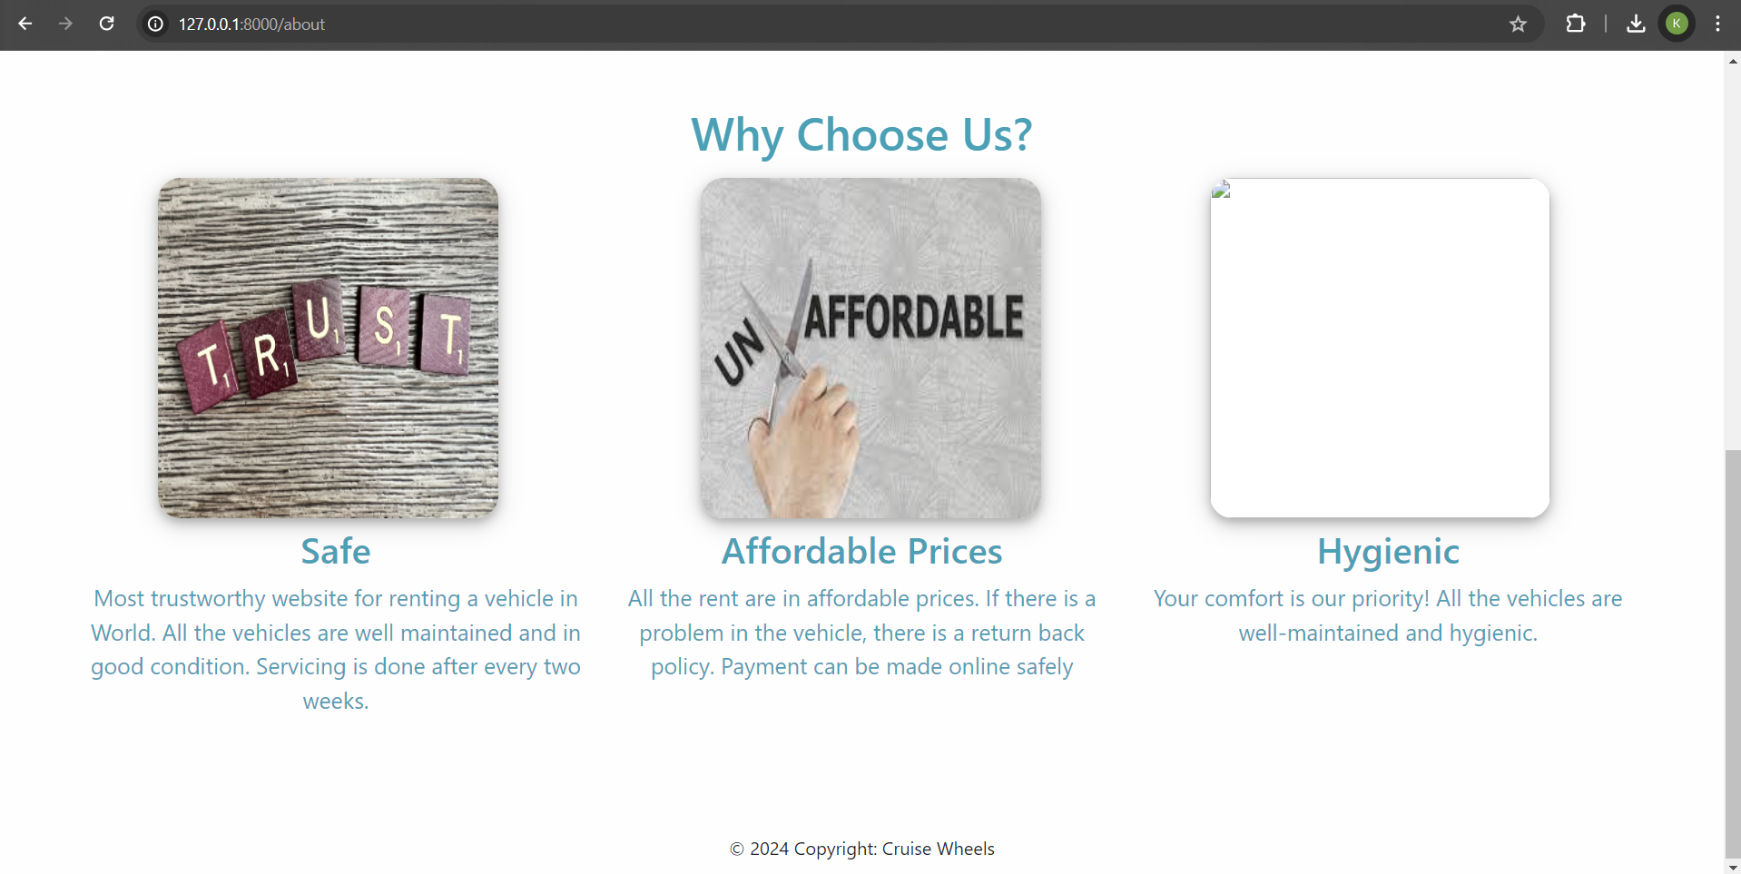
About-Us-Page

Slide 13
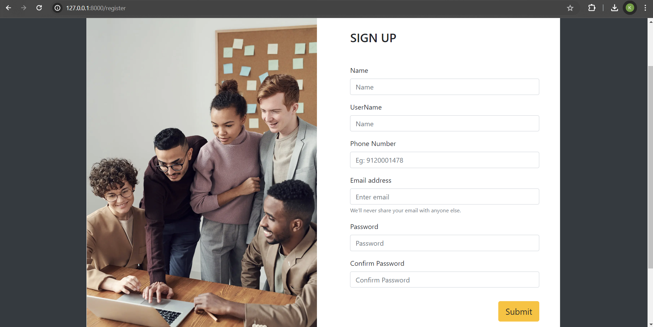
Sign Up-Page

Slide 14
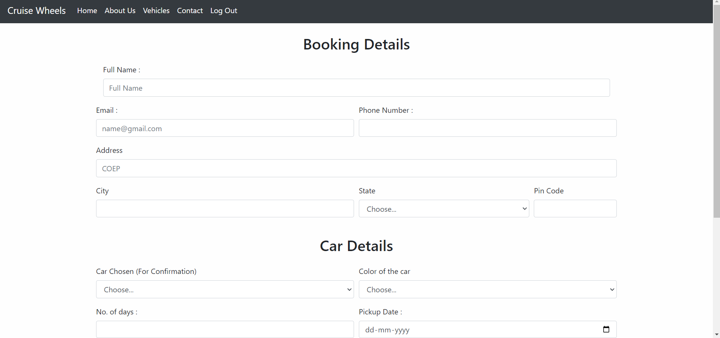
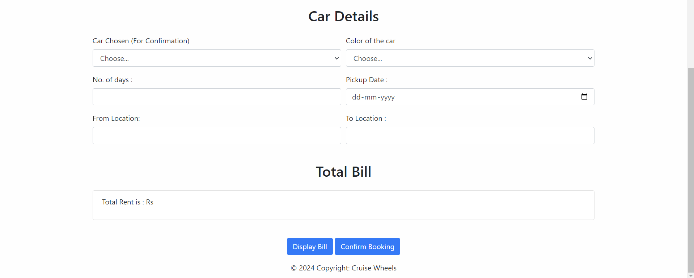
Booking-Page

Slide 15
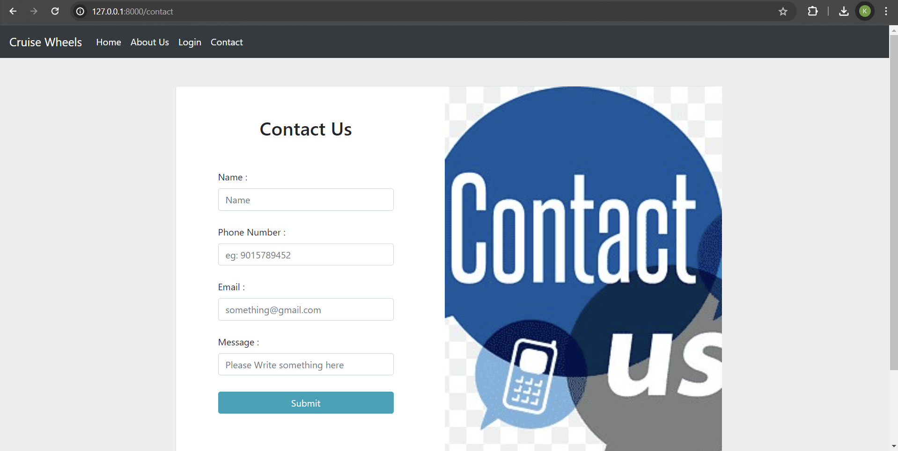
Contact-Page

Slide 16
Future Enhancements:
Loyalty Program Integration
AI-Powered Vehicle Recommendations
Blockchain-Based Rental Agreements
Augmented Reality Car Inspection
Sustainable Vehicle Options
Voice-Activated Booking
Dynamic Pricing Algorithms
In-Car IoT Connectivity
Integration with Ride-Sharing Services
Gamification for User Engagement

Slide 17
Conclusion
In summary, the Car Rental Application developed with Django and modern web technologies offers streamlined rental services. With advanced features like secure payments and user feedback, it enhances efficiency. Future integrations such as loyalty programs and AI recommendations promise continued innovation and improved user experiences in the evolving car rental industry.
Source :

Slide 18
Thank You!
Notes:
Thank You !!

